Slide 1

NABW ORGANISATIONAL PROFILE

Slide 2
About Us
NABW is a women founded and led Non-profit and Non-governmental organisation dedicated to empowering women in business and leadership roles. Founded in 1990 as an NGO under the Trusteeship Act of 1962 of the Laws of Malawi. We operate across three key thematic areas: economic empowerment, social advocacy, and climate action. Our Mission is to empower and uplift the lives of women economically and socially through entrepreneurship development, skills training, market access, information dissemination, access to finance and advocacy
WHO WE ARE

Slide 3
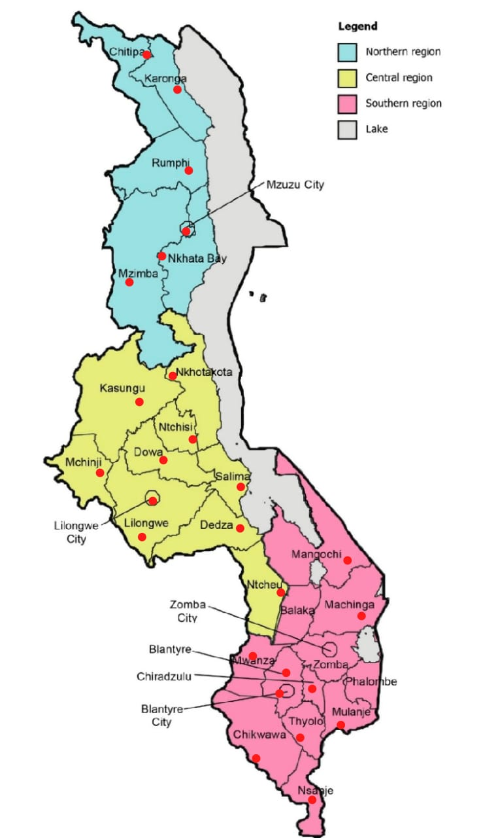
7,000
NABW boasts a diverse membership base comprising 7,000 women-led MSMEs
Location
South
Central
North
40%
35%
25%
35%
65%
Youth Members
Women Members
= NABW membership

Slide 4
Our purpose
Vision
Mission
To empower and uplift the lives of women economically and socially through entrepreneurship development, skills training, market access, information dissemination, access to finance and advocacy among urban and rural women
Liberated, socially empowered and economically active women of Malawi who contribute significantly to the political and economic development of Malawi

Slide 5
Our values
Legitimacy
Resourceful
02
01
We always strive to be the legitimate voice for all women (not only our members) doing various businesses in Malawi
We always strive to be resourceful in order to generate all the needed expertize to help women in their business activities; and help entities in Malawi create environments where women businesses can prosper
03
Accountable
Honesty
04
We are a membership led organization, and therefore, our members always inform what we do. Our members inform our direction and the strategies we take
We always strive to be honest in all our undertakings within ourselves as a membership led organization as well as all partners and duty bearers we work with.

Slide 6
Thematic Areas
Economic Empowerment
01
NABW is committed to enhancing the economic status of women through various programs and initiatives aimed at supporting women entrepreneurs and professionals
Business Mentorship Programme
Financial Literacy Workshops
Microfinance Initiative
Provides resources, mentorship, and funding opportunities for women-owned startups and small businesses
Offers training sessions on budgeting, investing, and financial planning to help women gain financial independence
Facilitate access to low-interest loans and grants to women entrepreneurs to start or expand their businesses

Slide 7
Social Advocacy
02
We strive to address social issues affecting women and advocate for policies that promote gender equality and women's rights
Women’s Leadership Trainings
Advocacy Campaigns
Community Outreach
A training program that equips women with leadership skills and knowledge to excel in various sectors
Focuses on lobbying for gender-sensitive policies and legislation at local, national, and international levels
Engages in community-based projects to raise awareness on issues like gender-based violence, health and social accountability

Slide 8
Climate Action & Renewable Energy
03
Recognizing the impact of climate change on communities, especially women, NABW integrates climate action and renewable energy into its core activities
Green Business Initiative
Climate Education Programs
Green & Inclusive Energy Advocacy
Encourages and supports women-led businesses to diversify to renewable energy enterprises and adopt sustainable practices and technologies.
Provides educational resources and training on climate change and environmental sustainability
We advocate for Increased participation of women in national energy planning, Investments and supply chain.

Slide 9
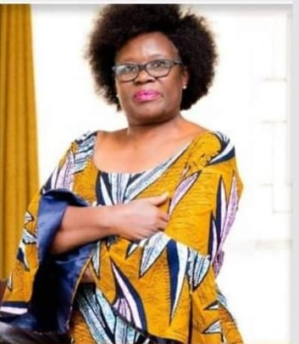
Meet our ED
Barbara Banda
Executive Director with over 30 years experience in development management in sub-Saharan Africa region. She has served in various leadership positions, chairperson for NGO Gender Coordination Network and Former board member for National Economic Empowerment Fund. She holds MSc in Development Management

Slide 10
Our Structure
NABW has 7 board of directors composed of credible and professionally respected, trusted and experienced business women. These are elected at the Annual General Assembly to govern the operations of the organisation. The board has a mandate to recruit a visionary, experienced Executive Director to manage the daily operations of the organisation. At the technical level, it is composed of 4 permanent staff and 3 volunteers
Board of Directors
Executive Director
Finance & Admi officer
Programme Manager
Volunteers
MEAL Lead
AGM

Slide 11
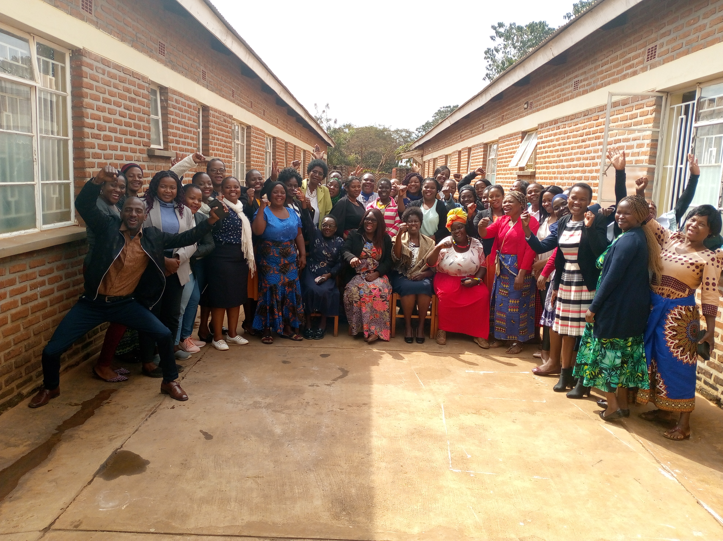

OUR RECENT WORK & ACHIEVEMENTS

Slide 12
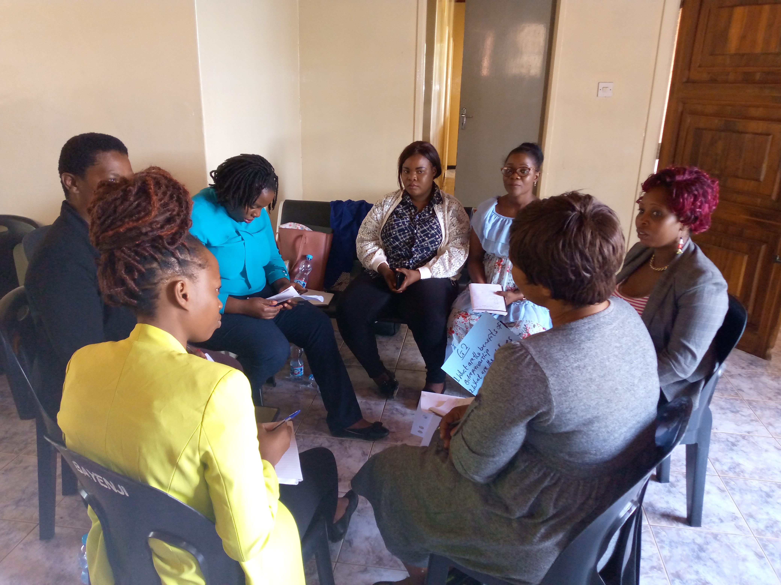

Entrepreneurial behavior, life skills and Leadership
“Building strong foundations”
Trained 77/90 women representing 85% of total targeted women
Improved self-confidence and decision making abilities
Atleast 80% of participants taking on leadership roles within their communities or business networks.

Slide 13
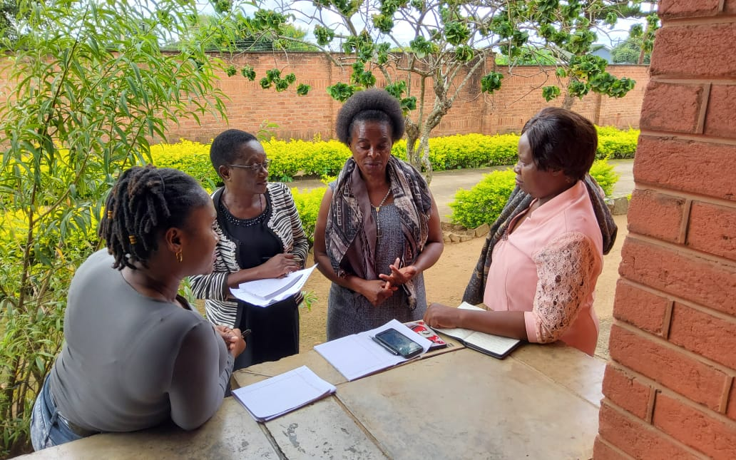

Financial Literacy, Management and Record Keeping
“Empowering financial independence”
Trained 77/90 representing 85% of total targeted women
Improved financial literacy: participants demonstrated an average of 85% increase in financial literacy knowledge
Improved business management practices with 80 % reporting they implemented changes in their businesses.
Record Keeping excellence; 90 % of participants now have organized financial records compared to less than 50% from the start of project.

Slide 14
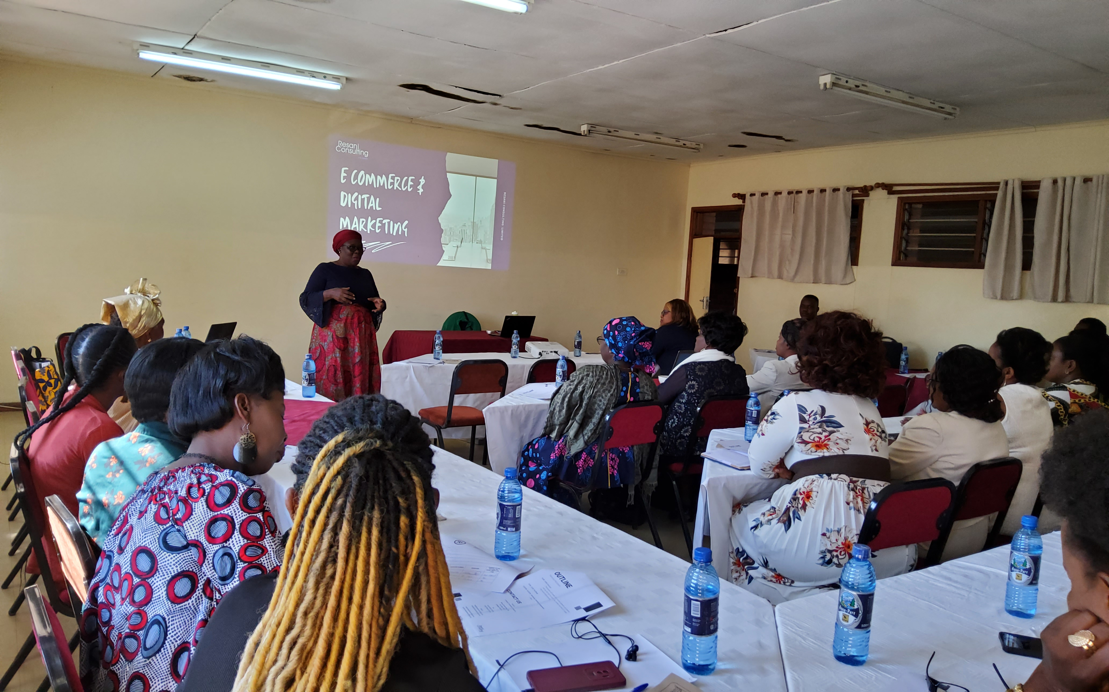

E-commerce and digital Marketing
"Nurturing Online Presence"
Trained 90/90 representing 100% of the targeted women.
Successful adoption of e-commerce & digital marketing with 70% of participants established or improved their online presence.
70% increase in digital marketing knowledge and ability to create effective online marketing campaigns

Slide 15
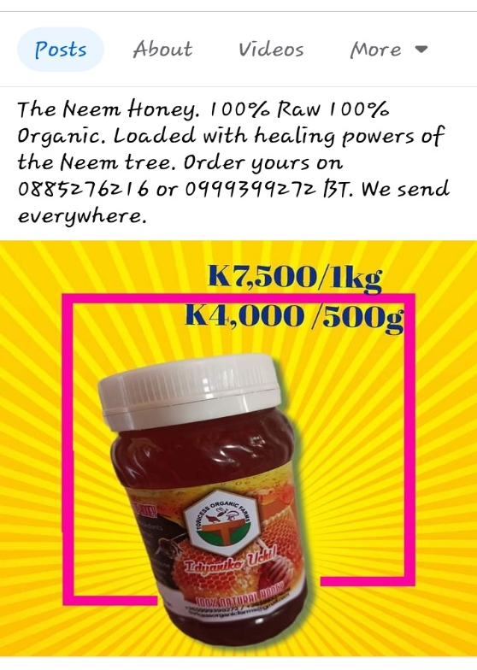
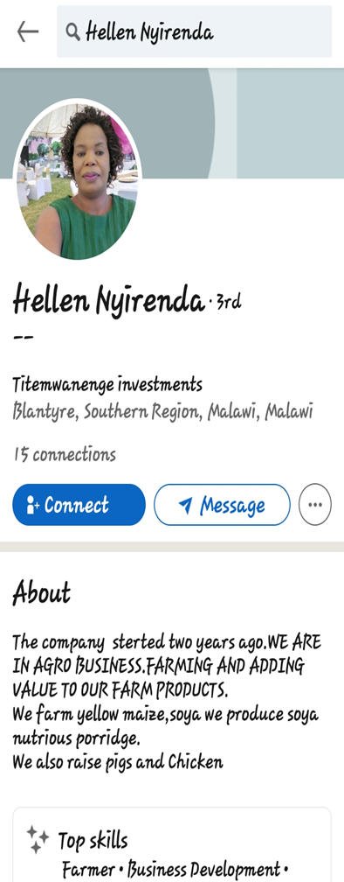
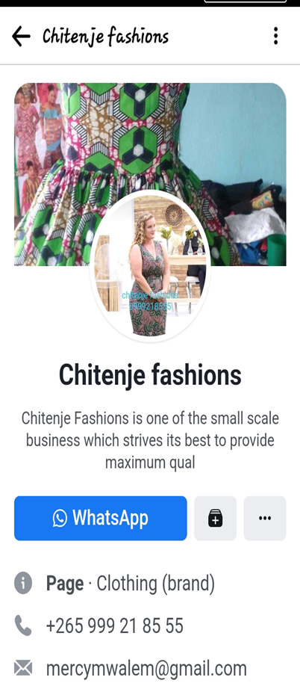
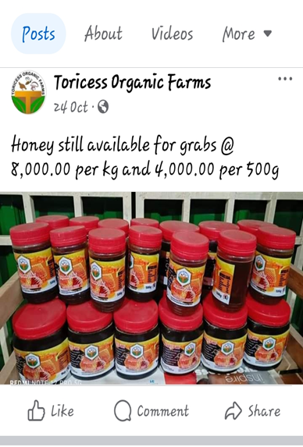
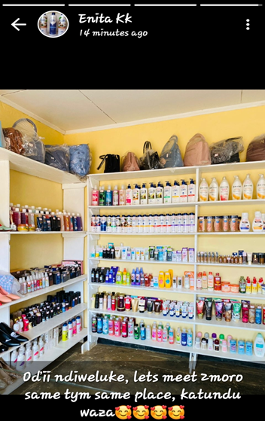


Slide 16
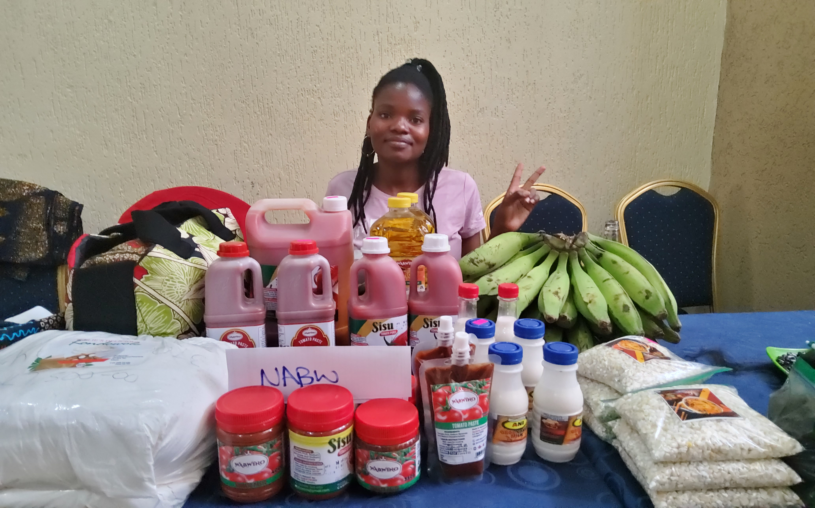

Product development and quality control
"Innovation and Quality Assurance"
Trained 64/60 women entrepreneurs exceeding the target
Quality improvements in products enhancing the competitiveness of women-led businesses in the market.
New Product Development: 70 % of participants successfully developed or improved existing product contributing to business growth.

Slide 17
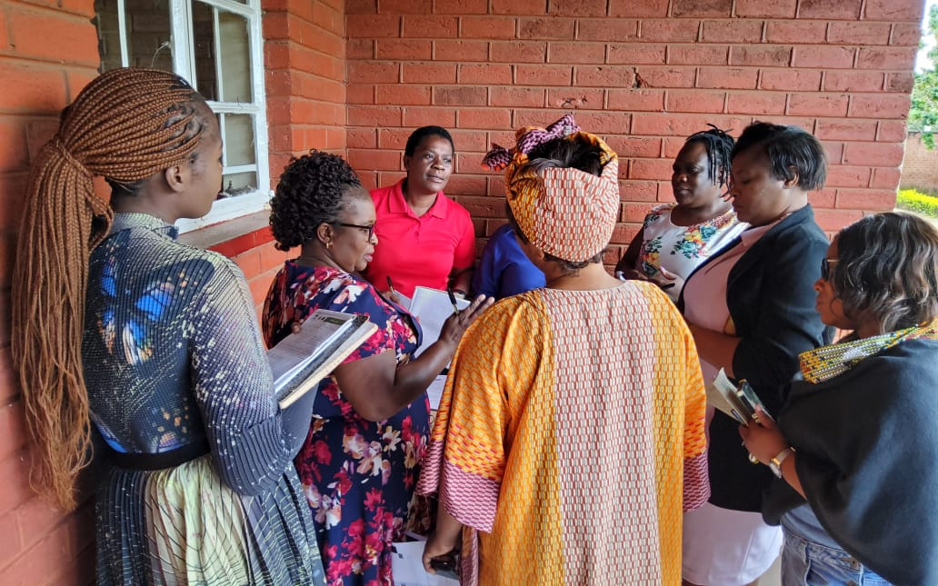

Mentorship program
"Guiding Paths to Success"
Trained 28/30 representing 93% of the targeted mentors
Each assigned atleast 3 mentees
Program Assist in business formalization impacting credibility of women businesses

Slide 18
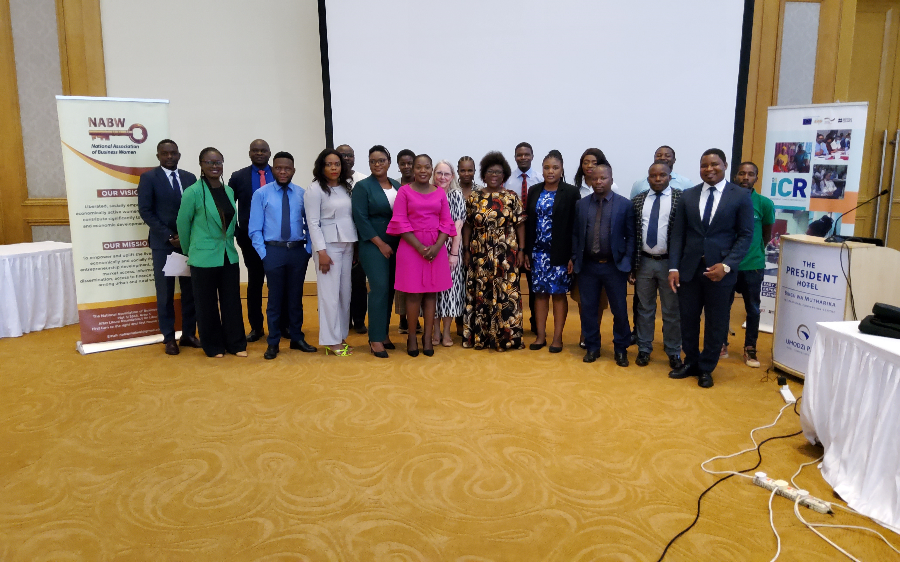
Building Back Better After Climate Related Events
From 2023-2024,NABW is receiving Technical Assistance from the Investment Climate Reform (ICR) Facility to support women owned businesses to build back better after climate related events and other external shocks.
As the incidence of such events has increased in Malawi in recent years, the lack of business risk assessment tools and mitigation strategies have negatively impacted the ability of women owned businesses to recover. The key outputs from this initiative will be (i) a technical study that will assess the current situation and make recommendations as to how to support women owned businesses through policy, programmes and products; (ii) a training manual for use by NABW and their partners to support women owned businesses, supported by associated training; and (iii) a policy brief and gender climate checklist to highlight key actions for business environment reform

Slide 19
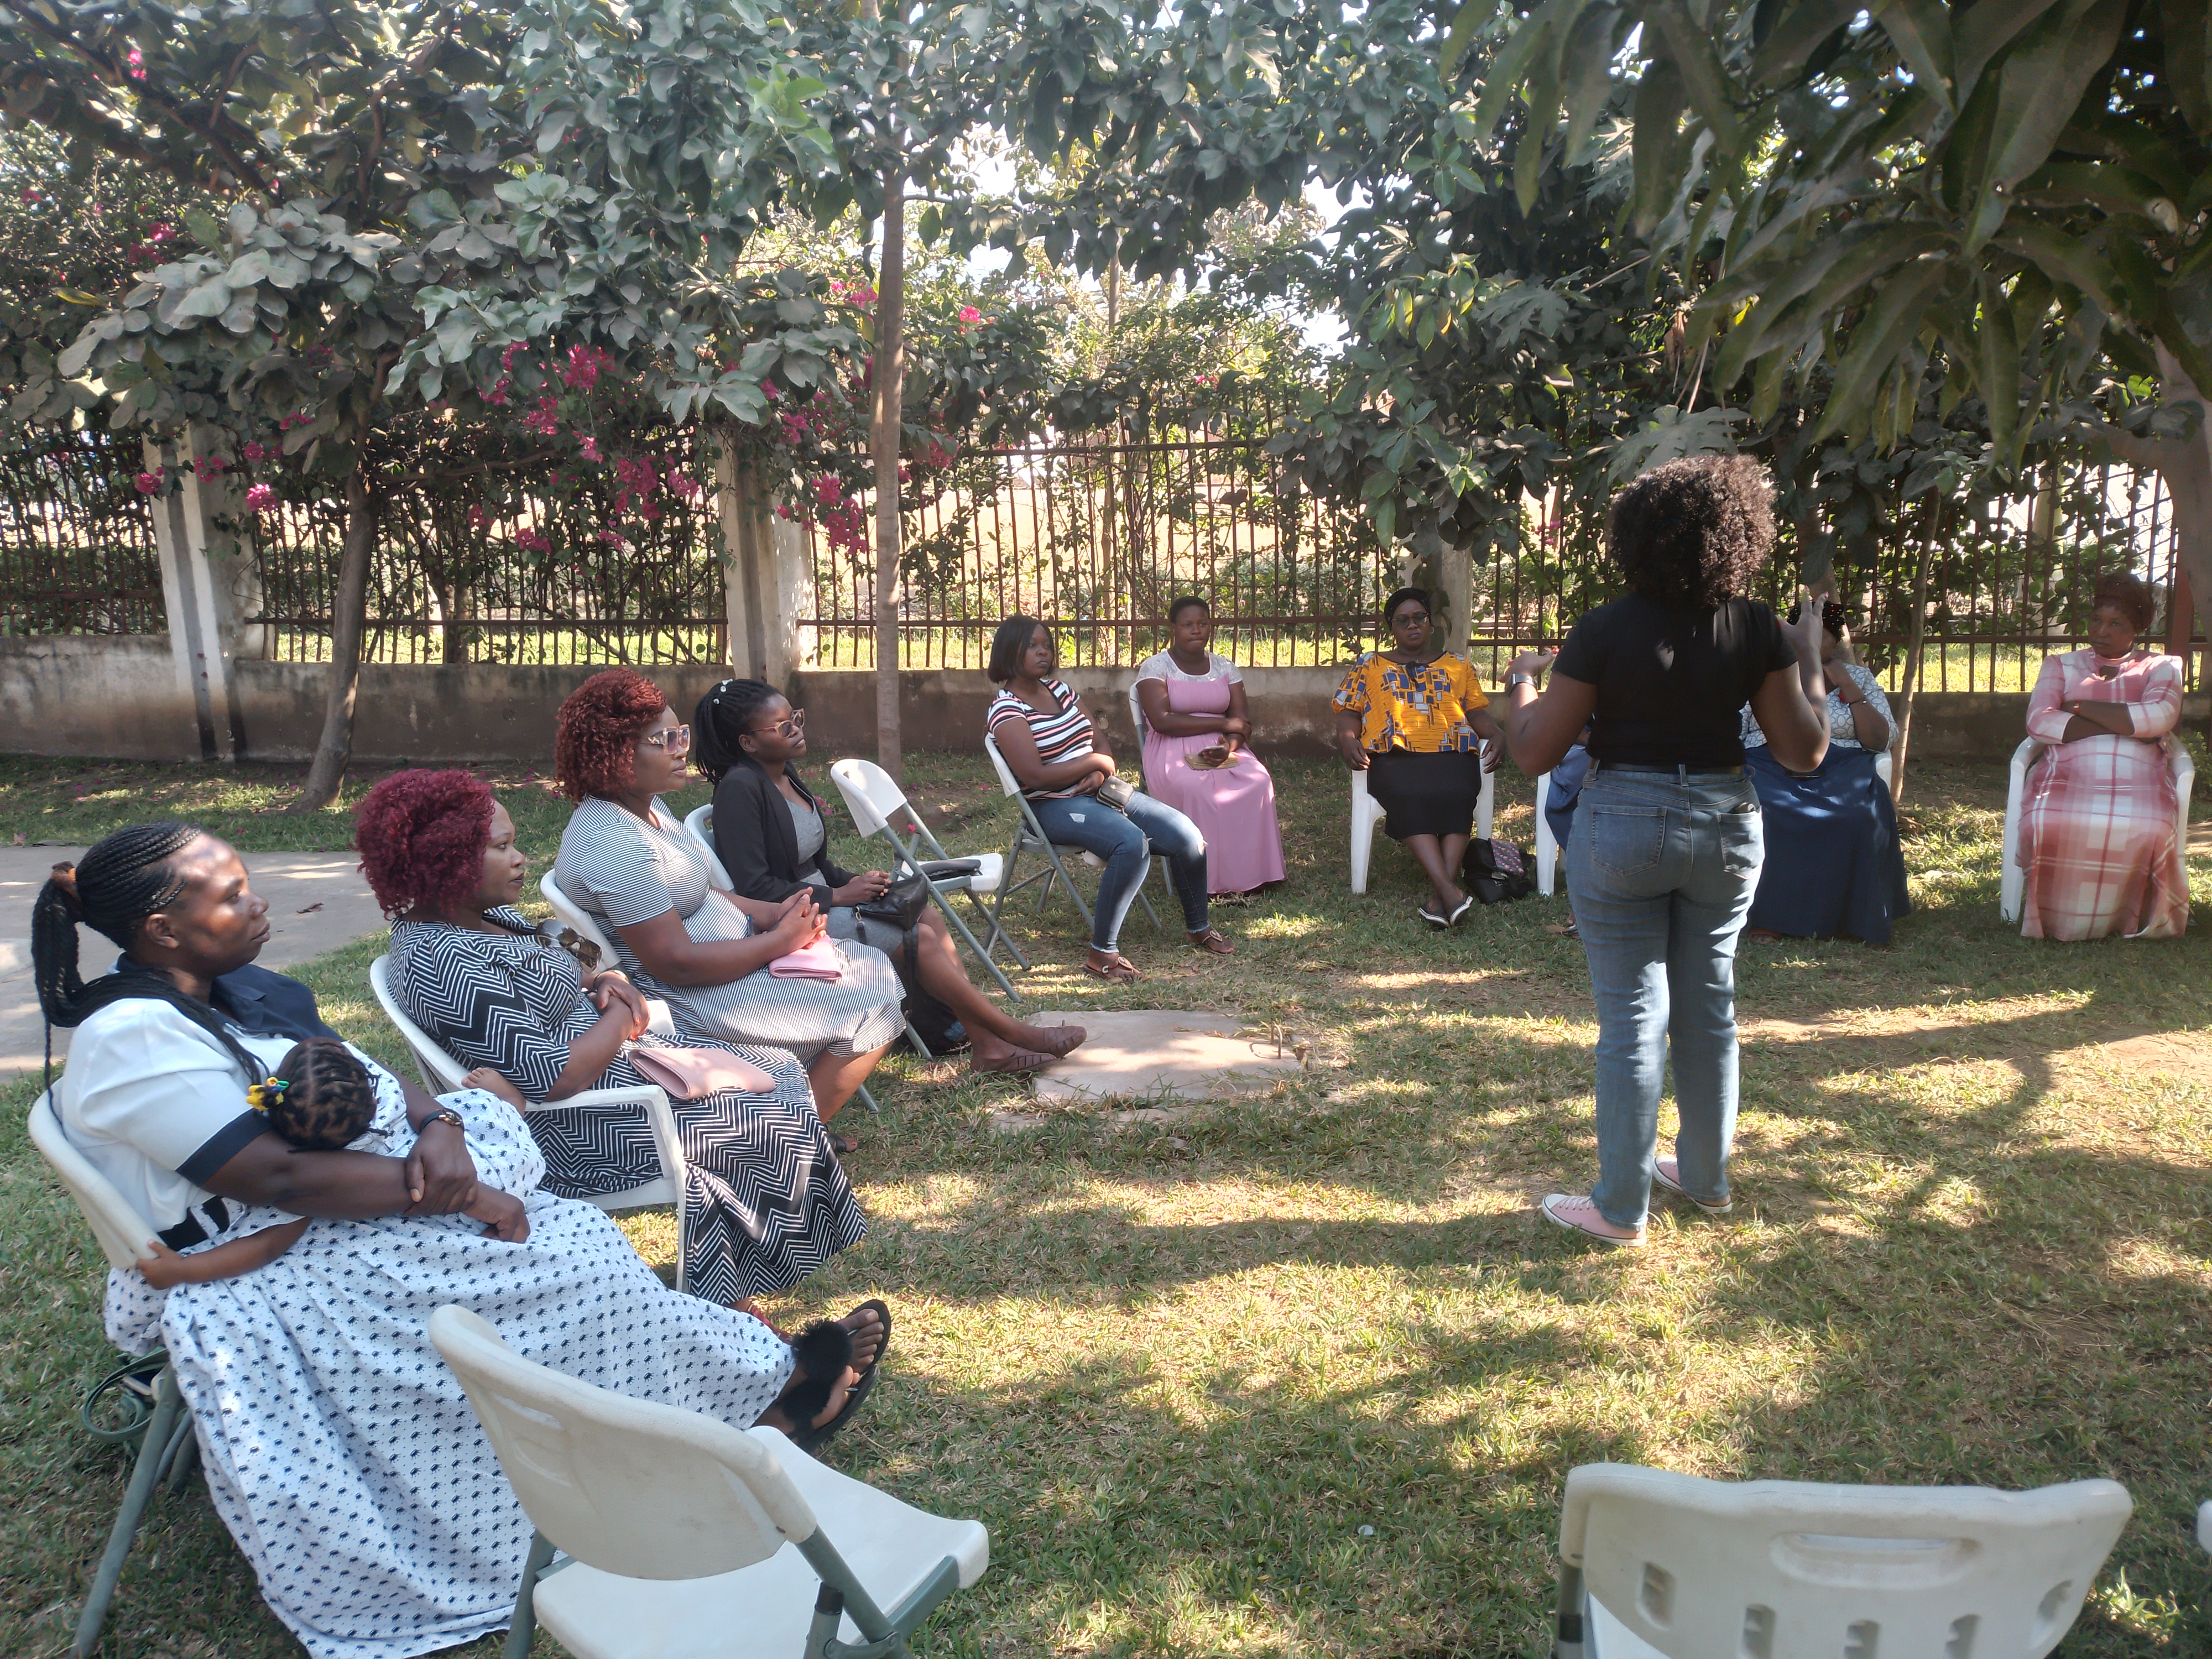
Promoting Insurance Coverage among Women-owned Businesses
This project was designed to due the aftermath of Cyclone Freddy. The cyclone resulted in the significant loss of products, capital, and markets, for SMEs especially women-owned SMEs which most of them were uncertain about how they will recover from the cyclone shocks. NABW recognizes that climate change-related hazards such as cyclone Freddy will continue to pose a threat to SMEs, and promoting insurance coverage among women-owned businesses is an essential step towards mitigating and adapting to these risks and promoting economic rights.
We conducted a quick mini survey, aimed to gain an understanding of insurance companies operating in Malawi, specifically those offering products tailored to benefit women-owned SMEs.
In partnership with CIC-Africa Cooperative Insurance Limited, we conducted awareness campaign meetings in the 10 districts affected by cyclone Freddy with NABW members eencouraging women-owned businesses to invest in insurance policies that can protect them from climate-related risks.

Slide 20
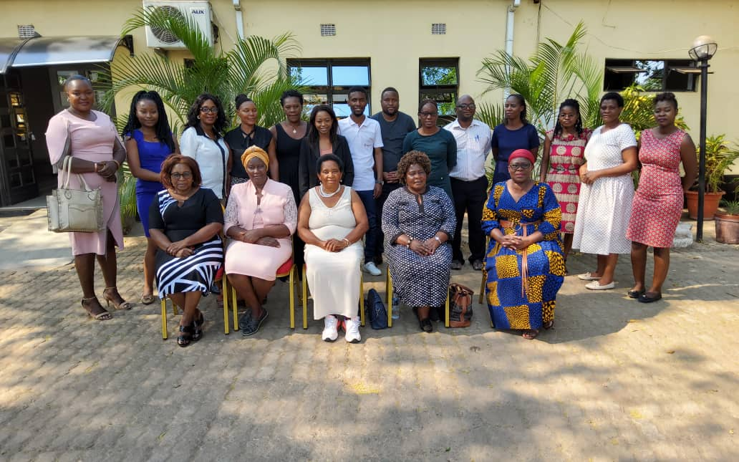
SheActs4Feminomics
In 2022, NABW with financial support from Urgent Action Fund implemented a six months project called SheActs4Feminomics project which is run by a consortium of Five Civil Society Organisations namely; For Equality, CEWAG, MHRRC, and Chikulamayembe Women Forum. The project aimed to address macro-level policies and their role in shaping policies that impact women’s economic justice and rights, to achieve greater impact in Malawi. Specifically, NABW’ objective in this intervention was to strengthen macro-level policy and regulatory frameworks to address challenges faced by women owned SMEs.
We conducted the following workshops;
1.Gender mainstreaming in SMEs policies, strategies and programmes workshop.
2.Policy dialogue on Public procurement and business formalization
3.Plenary session on achieving economic justice for women owned SMEs

Slide 21
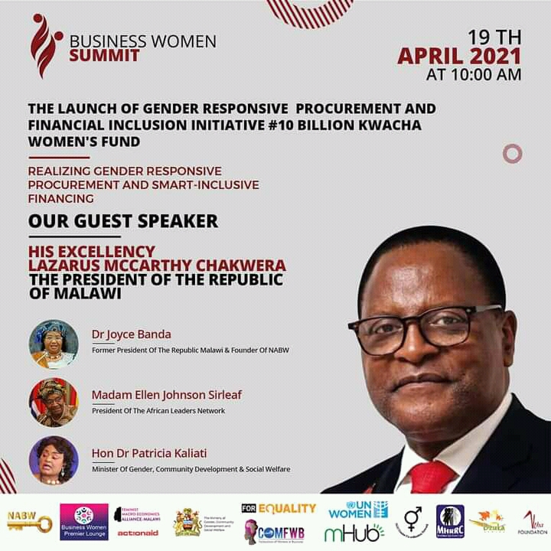
Advocacy & Campaigns
In 2020, NABW led a Financial Inclusion and Gender Responsive Procurement Advocacy campaign through a workshop that was attended by the State President and cabinet ministers. Private sector participants included banks and business development consultants. As a result a Financial Inclusion Index has been developed to monitor financial institutions.

Slide 22
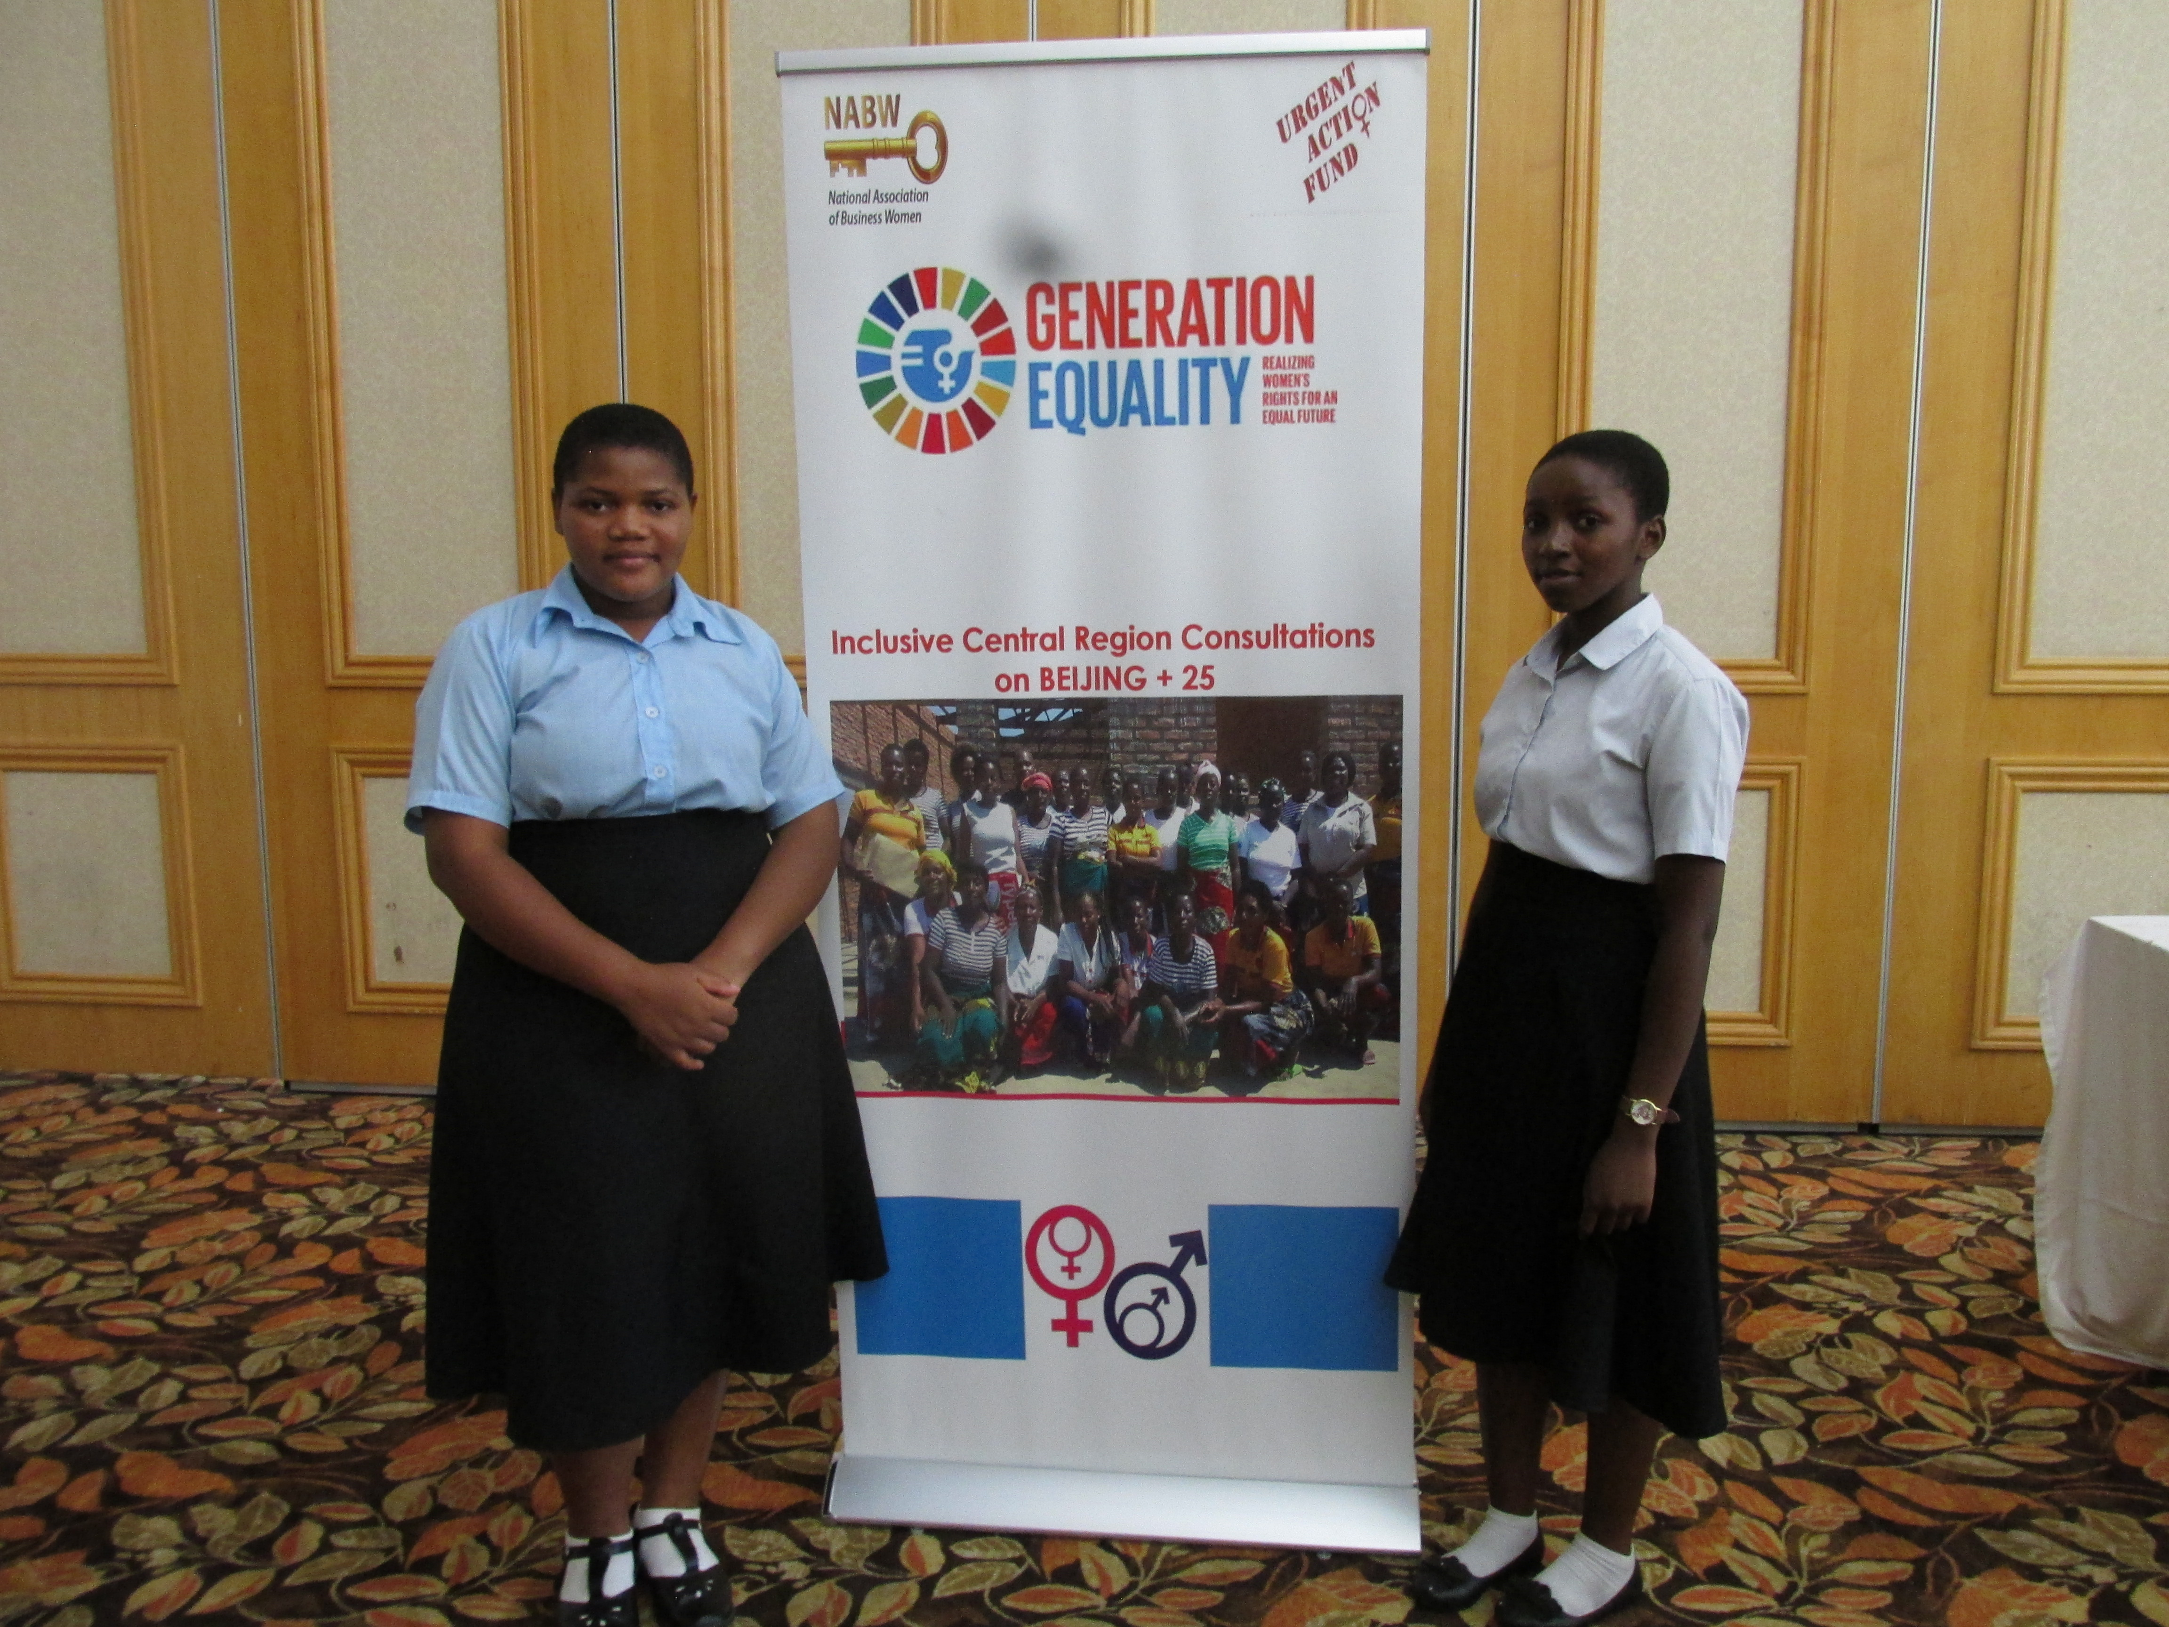
Beijing Declaration Platform for Action + 25
In a year 2020, with funding from Urgent Action Fund, NABW and other CSOs like NGO GCN, MHRRC, WOLREC and MBAWEMI conducted consultations where we were obligated to look into achievements and gaps that we have been able to implement since the adoption of the BPFA in 1995.
Questions that were needed to be answered includes, what has not worked, what are the new emerging challenges for women and what could be done to forge ahead.
Twenty five years after the adoption of Beijing Platform for Action, do more women and girls have access to free quality education, reproduction health and rights services and whether there is a gradual increase in women positions of power and decision making

Slide 23
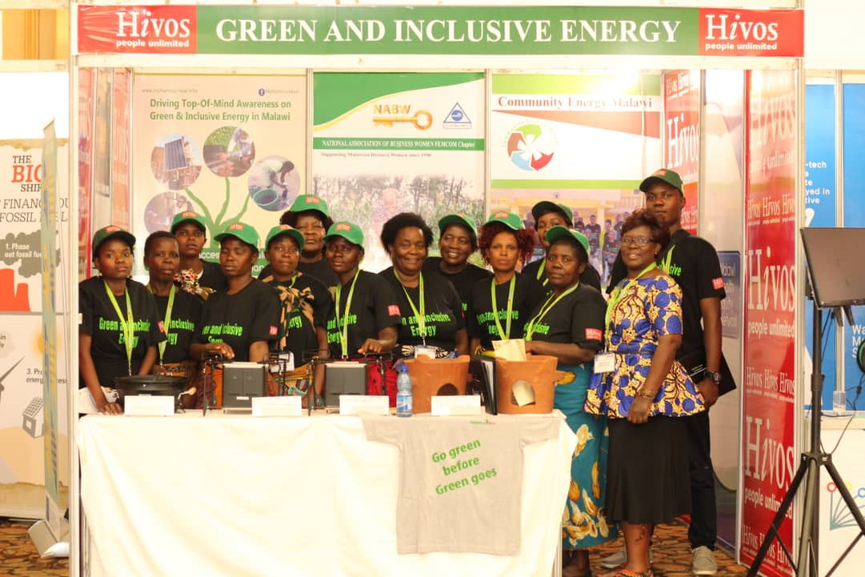
GREEN & INCLUSIVE ENERGY-GIE
Hivos 5-year funded project started in 2016-2020 to help alleviate the energy poverty situation in southern Africa through lobby and advocacy to influence the debate on energy, with the ultimate aim of making energy systems more green and inclusive (for women, children and the marginalized). It envisioned a green and inclusive energy system that creates economic opportunities and growth whilst mitigating climate change.
In Malawi the GIE project had the same focus of evidence-based advocacy including building capacities among stakeholders for their participation in the energy sector. The partners implementing the project in Malawi were; National Association of Business Women (NABW)), Community Energy Malawi (CEM), Malawi Health Equity Network (MHEN), Youth Network and Counselling (YONECO) and Renew n Able Malawi.
NABW’s role was to establish a ‘Gender and Energy Platform’ in Malawi and to support consortium members to achieve the objective to meet the energy needs of women and youth in their activities. NABW, in view of its national representation of women run businesses will build the capacities of its members to participate in the energy supply chain including access to energy investment opportunities

Slide 24
OUR PARTNERS
Urgent Africa Fund
Christian Aid Malawi
NGO Gender Coordination Network
World University Service of Canada- WUSC
Hivos Peoples Unlimited
Graca’ Machel Trust –GMT
National Economic Empowerment Fund
British Council
GIZ Malawi
CIC insurance Limited
Dreams Microfinance
First Capital Bank
Fines Project- Reserve Bank of Malawi
Micro-loan Foundation
For Equality
Mbawemi
Cross Boarder Traders Association
Malawi Union of SMEs
SMEDI
CISONECC
Line Ministries (Trade, Gender, Energy, Agriculture, )
Malawi Bureau of Standards
NABW works and collaborates with other likeminded organisations, actors and networks. These also includes those that support our work

Slide 25
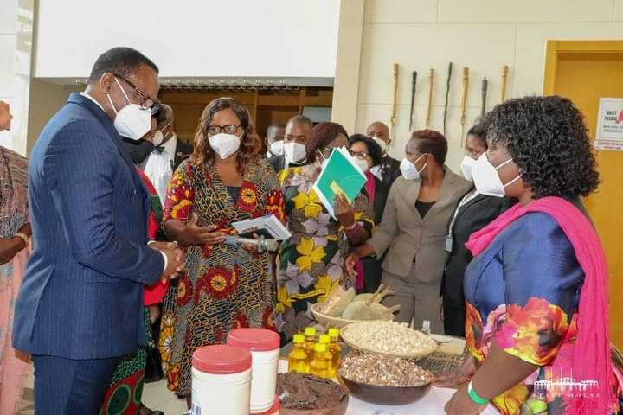
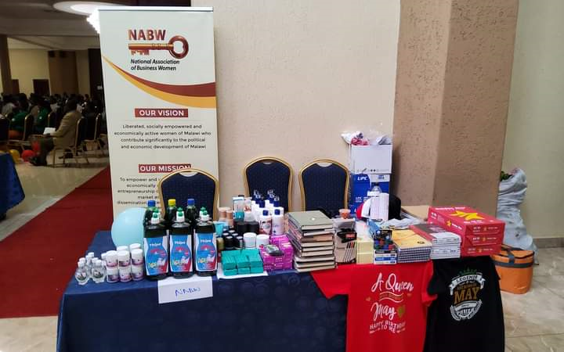
CONTACT INFO
Location Address: Plot 3/3345, Area3, Likuni Road.
Postal Address: P.O Box 40442, Kanengo, Lilongwe
Email : nabwmalawi@gmail.com
Cell: +265 995 752 813 |+265 888285280
Facebook: https://web.facebook.com/profile.php?id=100064032041715
Website: nabwmalawi.wixsite.com/website

